Slide 1

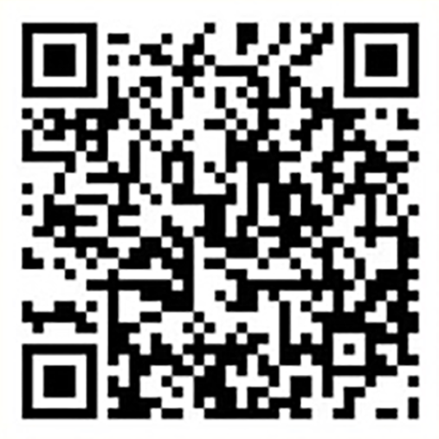
DEADLINE
03/29/24
The Kimmy Duong Foundation Announces
2024 - 2025
The Long Nguyen and Kimmy Duong Scholarship Program
FOR THE FOLLOWING SCHOOLS
Scan QR Code for Application
Diamond Prize - $3000
Gold Prize - $2000
Silver Prize - $1000
The University of Maryland (UMD-CP, UMB, UMBC)
George Mason University (GMU)
NOVA Community College (NOVA)
Virginia Tech (VT)
University of Virginia (UVA)
Virginia Commonwealth University (VCU)
Montgomery College (MC)
Renewable up to 4 years
APPLICATION LINK: thekimmyduongfoundation.org/portfolio/applying

